Slide 1
Brander-Krugman Model of Intera Industry Trade
Dr. Neha Paliwal
Assistant Professor
Department of Economics
UCSSH, MLSU

Slide 2
Assumptions:
There are two countries, which are identical in all respects.
The commodity is homogeneous
There is one producer in each of the two countries.
Each producer has equal costs of production.
Total cost function is linear in the two countries.
The domestic demand function is identical in the two countries.
Both the firms display Cournot behaviour i.e., each firm assumes that the supply of the rival firm will remain constant

Slide 3
Model
Linear Cost Function
C=a+bQ here Q= Q₁¹+ Q₁²
Demand Function in country i given as:
P^{i}=c-d(Q₁^{i}+Q₂^{i})
i=1 for Domestic Country, i=2 for Foreign Country
Revenue to the domestic producer by selling in home country:
R₁¹=[ c-d(Q₁¹+Q₂¹) ]* Q₁¹
Revenue to the domestic producer by selling in foreigncountry:
R₁²=[ c-d(Q₁²+Q₂²) ]* Q₁²

Slide 4
Model cont......
Total Revenue of domestic producer
R₁=R₁¹+ R₁²
=[ c-d(Q₁¹+Q₂¹) ]* Q₁¹+[ c-d(Q₁²+Q₂²) ]* Q₁²
Total production cost
C₁=a+b(Q₁¹+ Q₁²)
Profit Function
M₁= (R₁¹+ R₁²)- C₁
Or M₁=[ c-d(Q₁¹+Q₂¹) ]* Q₁¹+[ c-d(Q₁²+Q₂²) ]* Q₁²- [a+b(Q₁¹+ Q₁²)]

Slide 5
Model cont......
Profit Maximisation First Order Condition For Domestic Producer
∂ M₁/∂ Q₁¹=c-2d Q₁¹-d Q₂¹-b=0 ........(i)
∂ M₁/∂ Q₁²=c-2d Q₁²-d Q₂²-b=0............(ii)
Profit Maximisation First Order Condition For Foreign Producer
∂ M₂/∂ Q₂¹=c-2d Q₂¹-d Q₁¹-b=0.......(iii)
∂ M₂/∂ Q₂²=c-2d Q₂²-d Q₁²-b=0..........(iv)
Equilibrium for domestic market can be achieved by solving equations (i) and (iii)
Equilibrium for domestic market can be achieved by solving equations (ii) and (iv)

Slide 6
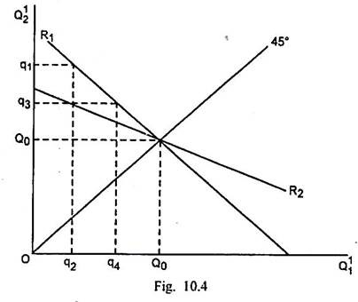
Equilibrium in Domestic Market

Slide 7
Thanks!

